Slide 1
Spatial Data Quality

Slide 2
Cont.
Data quality standards must serve the needs of the users according to their budget, technical capabilities, and rate of production.

Slide 3
Components of spatial data quality
There are 9 components that affect the quality of the data.
These components have been grouped into 3 categories are:
1.Micro Level Components
2.Macro Level Components
3.Usage Components.

Slide 4
Micro Level Components

Slide 5
Micro level components
Micro level components are data quality factors that pertain to the individual data elements.
Positional Accuracy
Attribute Accuracy
Logical Consistency
Resolution

Slide 6
Micro level components
Positional Accuracy:
is the expected deviation in the geographic location of an object in the data set from its true position
There are two components to positional accuracy are;
Bias
Precision
The bias refers to the systematic discrepancies between the represented and true position. Ideally the bias should be zero.
Bias is commonly measured by the mean / Average positional error of the sample points.

Slide 7
Micro level components
Positional Accuracy:
Precision refers to the dispersion of the positional errors of the data elements.
Precision is commonly estimated by calculating the standard deviation of the selected test points.
A low standard deviation indicates that the data points tend to be very close to the mean
Higher the precision better the data for use.
Commonly the accuracy is measured in RMS error.

Slide 8
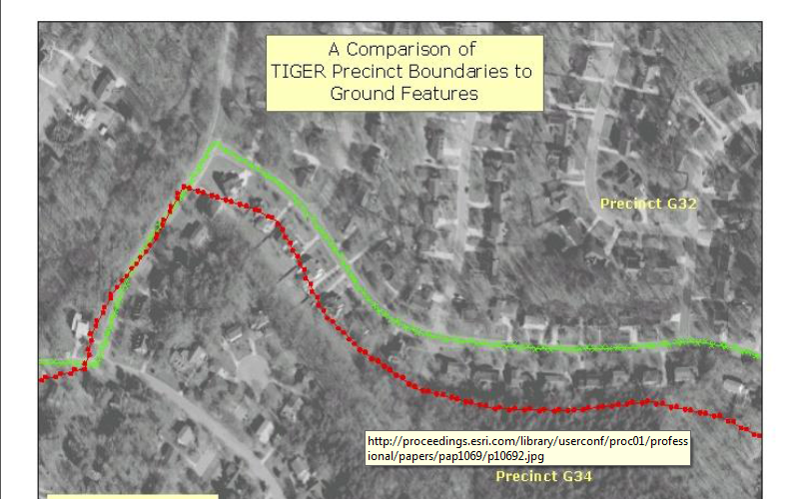

Slide 9
Micro level components
Attribute Accuracy: may be discrete or continuous variables.
A discrete variable can take on only a finite number of values e.g. Land use class, Vegetation type, or administrative boundaries.
Ratings is also discrete variables. They are ordered in categories where the order indicates the hierarchy of the attribute.
Low (1) to High (4)

Slide 10
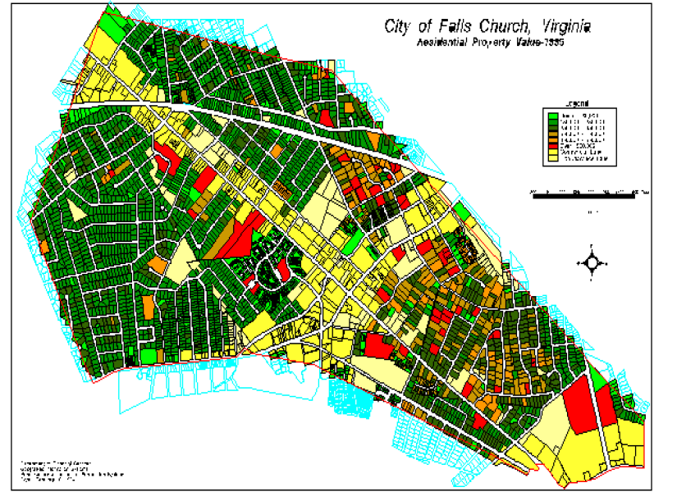

Slide 11
Micro level components
Attribute Accuracy:
Continuous variables can take on any number of value.
Temperature
Average property value are continuous
Hence, the variable can take on any value so intermediate values are valid.

Slide 12
Micro level components
Logical Consistency: refers to how well logical relations among data elements are maintained .
For Example
There must be a consistency between forest stand boundaries and to the center of adjacent roads
Political and administrative boundaries defined by physical features should precisely overlay those features.
The edge of the property that borders a lake should coincide with the lake boundary.

Slide 13
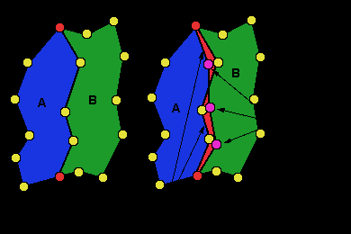
Micro level components

Slide 14
Micro level components
Logical Consistency: is best addressed before data are entered in GIS data base. Hence, there is no standard measure of logical consistency.
The map preparation stage includes to check, redraft (correct errors), and reconcile discrepancies , known as conflation process.

Slide 15
Micro level components
Resolution: of a data set is the smallest understandable unit or the smallest unit represented.
In aerial camera or in satellite images the smallest units that can be understood , called spatial resolution.
Area of the earth’s surface represented in a single digital image value is known as spatial resolution.
For thematic maps such as soil maps, land use maps, the resolution is the size of the smallest object that is represented , called minimum mapping unit.

Slide 16
Micro level components
Resolution: But geographic data stored in GIS data base can be represented at any scale.
Labeling and other map details can be added according to the required output scale.
Data do not have a specific scale, they are produced according to the resolution and accuracy required to produce intended results.

Slide 17
Macro Level Components

Slide 18
Macro level components
Macro level components of data quality pertain to the data set as a whole.
Such as;
Completeness
Time
Lineage

Slide 19
Macro level components
Completeness: is further sub divided into three parts are;
Completeness of coverage
Completeness of classification
Completeness of verification
The completeness of coverage is the proportion of data available for area of interest.
A data set may not provide complete aerial view or attribute data may not be available some of the data set.

Slide 20
Macro level components
Completeness of classification is an assessment of how well the cohesion classification is able to represent the data.

Slide 21
Macro level components
Forest (Conifer and deciduous classification)
Urban (Residential ,Commercial, Industry)
Water (Salinity classification)
Agriculture
Grains
Truck crops
Carrots
Tomatoes
Other
Live stock
Cattle
Hog
Sheep

Slide 22
Macro level component
Completeness of Verification refers to field measurements or other independence sources of information that were used to develop the data.
For example
A geologist can verify the quality of the data by applying solid line to a map rocks types as he has direct field evidence.

Slide 23
Macro level component
Time: is very important factor when using different types of geographic data such as demographic, Land cover.
The time aspect of data quality is most commonly reported as the date of the source material , such as the date of aerial photography.
Topographic maps include updated information.
Forest inventory maps may be updated on a 5 to 10 years.
Crop condition changes rapidly ,hence updated on a weekly basis.
Flood prone areas map are updated on daily basis.

Slide 24
Macro level component
Lineage: Processing steps to produce a data set is called lineage.
Transaction records
field notes
air photos and other maps.
Each data source and processing method introduces a level of error into the information that is ultimately produced.

Slide 25
Usage Components

Slide 26
Usage Components
Accessibility: refers to the ease of obtaining data .
Government held data
Privately held data
Direct and indirect cost of the data

Slide 27
Sources of error
Data collection
Data input
Error in field data collection
Error in base map
Error in the analysis of remote sensing data
Digitization error by operator or equipment

Slide 28
Sources of error
Data storage
Data management
Insufficient numerical precision
Insufficient spatial precision
Inappropriate class intervals
slivers

Slide 29
Sources of error
Data out put
Use of result
Scaling inaccuracies
Error caused by inaccurate of the output devices
Information may be incorrectly understand
Information may be inappropriately used

